Slide 1
An-Najah National University Research Day in Theoretical and Applied Physics "Measurement of Natural Radioactivity in Some Granite Samples : Prelimenary Results "
M. Mansour,M. Elhasan, G.Saffarini
Radiation Physics Laboratory, An-Najah National University
November, 23 - 2013

Slide 2
Presentation Outline:
Introduction
Objectives of the study
Experimental work
Results and discussion

Slide 3
Introduction

Slide 4
Granite is a popular building material.
Radiation exposures of the population can be increased appreciably by the use of building materials containing above –normal levels of natural radio nuclides Human beings are exposed also naturally from sources outside their bodies, mainly cosmic rays and gamma rays emitters in soil , building materials , water , food and air.

Slide 5
objectives
The objectives of this presentation, therefore, are to measure the natural radioactivity levels in two samples of granite, one sample is Brasilian granite the other is U.S.A Granite ( from california) using ɣ- Ray Spectrometry. Sodium iodide (Na I ( TI )) detector is used for the measurement.
The detector has a resolution of 9.5% at full Width at Half Maximum (FWHM) of Cs¹³⁷energy of 0.662 MeV. This was good enough to distinguish the ɣ-ray energies of interest in the present study.

Slide 6
Sample analysis The samples were analyzed at Radiation Physics Laboratory using (1.5’’× 2’’) sodium iodide detector. The samples were placed symmetrically on the top of the detector and measured for a counting time of 20 h . A homemade Marinelli beaker was used in the measurements.

Slide 7
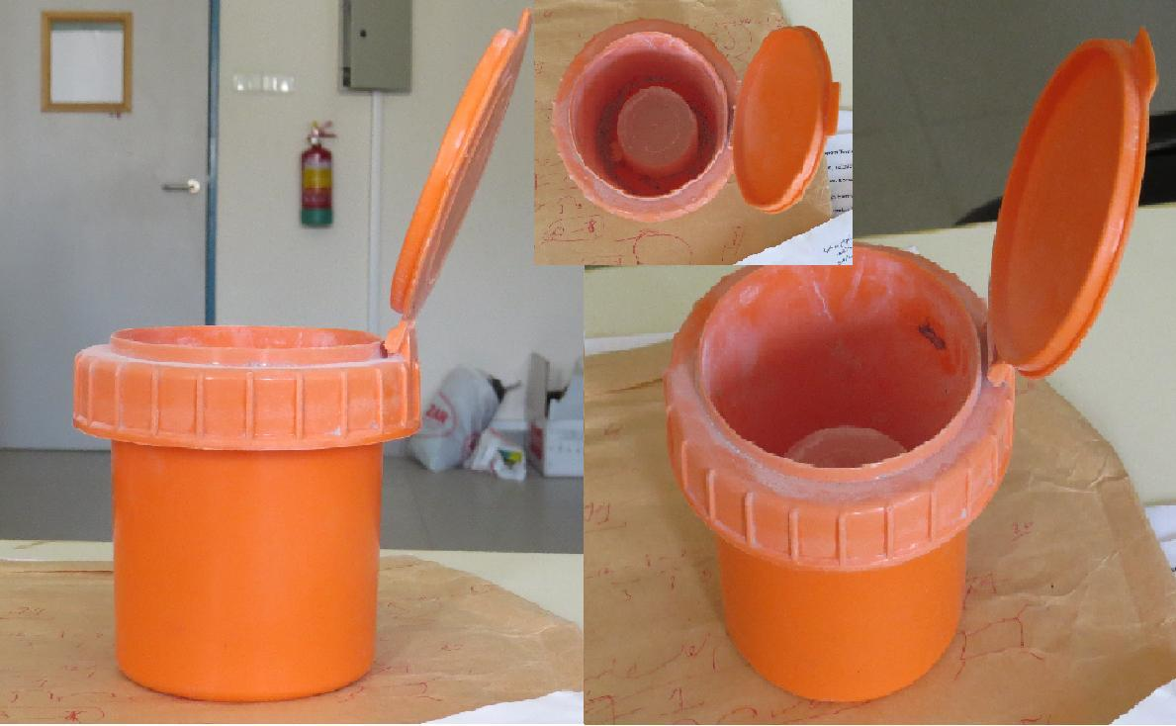
The figure shows the home-made Marinelli Beaker
Notes:
The figure shows Marinelli Beaker designed by M . Mansour in Radiation physics Laboratory

Slide 8
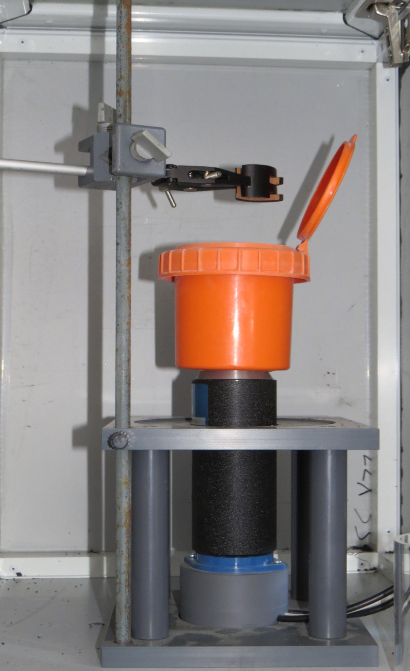
The figure shows NaI crystal coupled to a photomultiplier tube (PMT) with Marinelli Beaker
Notes:
The figure shows NaI crystal coupled to a photomultiplier tube (PMT) with Marinelli Beaker

Slide 9
Sample Analysis
The net area under the corresponding peaks in the energy spectrum was computed by subtracting counts due to background from the total area of the peaks as shown in the fig 2. From the net area , the activity concentrations of radio nuclides in the samples were obtained using the following eq.
C=N/E ×M × t × P
Where C is the activity concentration of the radionuclide
in the sample given in Bqkg⁻¹ , N= net peak area of a peak at given energy, E= efficiency of the detector for ɣ-energy of Interest, M=sample mass, t= total counting time and P= emission probability of radionuclide of interest.

Slide 11
Results and discussion The average concentration of U²³⁸ are found to be 62.7 and 39.9 Bqkg⁻¹ for brasilian and californian granite samples, respectively, and those corresponding to Th²³² are respectively,150.8 and 242.8 Bqkg⁻¹ . The reported average concentration U²³⁸ of granite for three samples from Brasil range from (9- 32 ) Bqkg⁻¹ (Pavlidou et.al. 2006 ). Results from studied samples in this work are slightly higher.

Slide 12
Measured Th²³² concentrations are, respectively, 150.8 and 242.8 Bqkg⁻¹ ,for Brasil and U.S.A granite samples.
Reported results for Th²³² range from2 to 46 Bqkg⁻¹ ) ( S. Pavlidou et. al. 2006).
Results of the average concentration of Th²³² for 137 granite samples from different countries range from 4 to 253 Bqkg⁻¹ (S.Pavlidou et. al. 2006) .
Results of the activities of U^{238 ,}Th²³² in the two investigated samples are higher than the average level of these radio nuclides in regular soil 35 Bqkg^{-1 ,} 30 Bqkg^{-1 ,}respectively.

